Slide 1

Amazon Fresh Analytics
Monisha Raja

Slide 2
Introduction
Domain Introduction : E-commerce and Retail Analytics focuses on analysing consumer behaviours, product performance, and operational efficiency to drive business growth. By leveraging data, platforms like Amazon Fresh can optimize supply chains, improve customer experiences, and maximize revenue.
Project Introduction : This project involves designing a relational database for Amazon Fresh to manage data on customers, products, orders, and suppliers. The goal is to enable meaningful analysis and support critical business decisions.
Objectives of the Project
Organize large volumes of e-commerce data efficiently for analysis.
Identify top-performing products, high-value customers, and revenue trends.
Optimize inventory and supply chain management to meet demand patterns.

Slide 3
Agenda
Project Overview
Problem Statement
Data Modeling & SQL Implementation
Business Use Cases
Actionable Insights
Project Deliverables
Conclusion & Evaluation Metrics

Slide 4
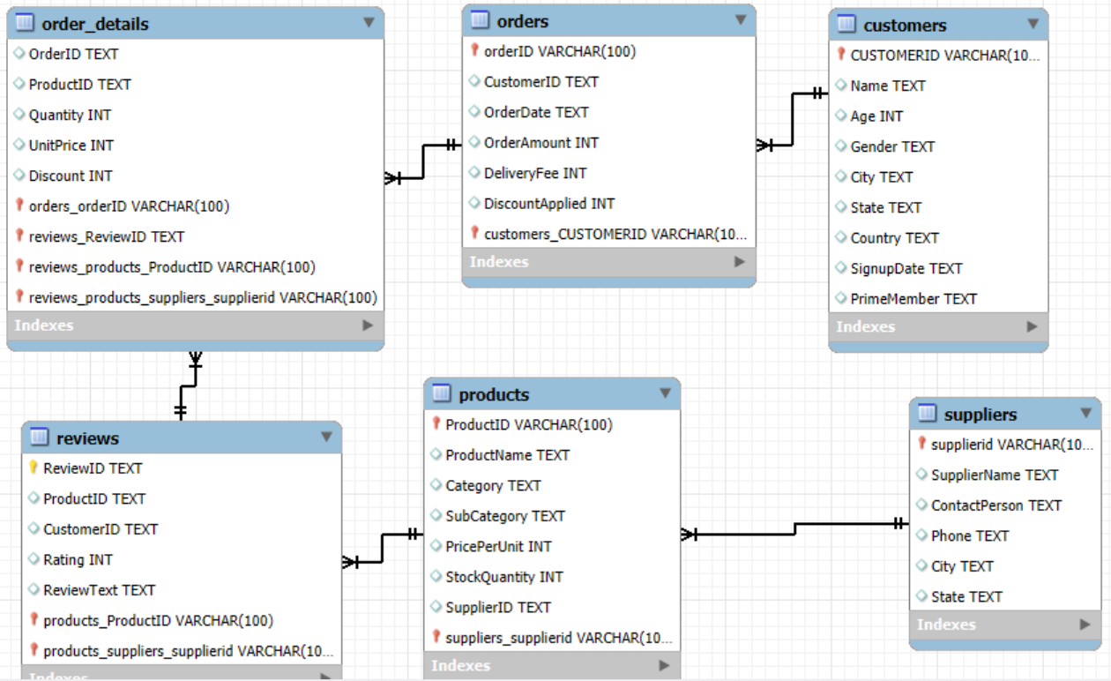
Task 1:Defining ER Relationships
SQL Approach: ALTER TABLE
Review table contain more relationship with other table.
Total relationship : 4
Supplier table contain less relationship with other table.
Total relationship: 1

Slide 5
Task 2 :Identify the primary keys and foreign keys for each table and describe their relationships.
🔑 Primary Keys (PK)
Uniquely identify each record in a table.
Ensure entity integrity
🔗 Foreign Keys (FK)
Link related records across tables.
Enforce referential integrity.
✅ Benefits
Ensures data integrity and accurate joins.
Supports scalable and relational design.
Prevents orphaned records and anomalies.
Detailed Explanation of Relationships
Table | Primary Key | Foreign Keys | Description
Customers | CustomerID | – | Each customer is uniquely identified.
Orders | OrderID | CustomerID → Customers (CustomerID) | A customer can place multiple orders.
Order Details | (OrderID, ProductID) | OrderID → Orders (OrderID) | Line items for each order.
 |  | ProductID → Products(ProductID)
Products | ProductID | SupplierID → Suppliers (SupplierID) | Each product is supplied by one supplier.
Suppliers | SupplierID | – | Provides products.
Reviews | Review ID | ProductID → Products (ProductID) | A customer can review a product.
 |  | Customer ID → Customers (Customer ID)

Slide 6
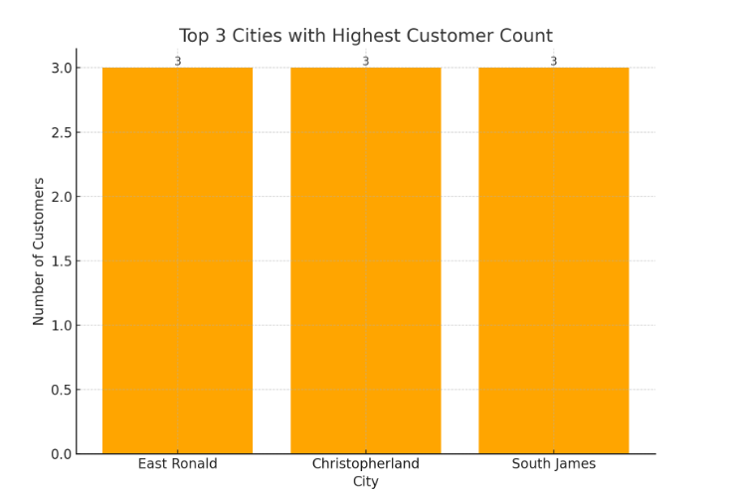
Task 3:
SQL Approach: SELECT TABLE and WHERE clause
Objective
Identify and retrieve:
Customers based on geographic location.
Products grouped under a specific category.
Use Cases
Enable targeted marketing and region-specific offers.
Filter products for inventory management or seasonal stocking.
Build dashboards for location-based customer analytics.

Slide 7
Task 4: Creating Customers Table with Constraints
Ensure Age cannot be null and must be greater than 18.
Primary Key: Customer ID ensures each record is uniquely identifiable.
• Age Constraints:
NOT NULL prevents empty values.
CHECK (Age > 18) enforces age validity.
• Unique Name: Guarantees no duplicate entries in Name.
Explanation of Each Constraint:
Column | Constraint | Description
CustomerID | PRIMARY KEY | Uniquely identifies each customer. No duplicates or NULLs allowed.
Name | UNIQUE | Ensures each customer name is distinct. Prevents duplicate names.
Age | NOT NULL CHECK (Age > 18) | Age cannot be NULL and must be greater than 18. Enforces a minimum age.
City | – | Optional column to store customer location.
IsPrime | – | Boolean flag to indicate Prime membership (TRUE/FALSE or 1/0).

Slide 8
Task 5: Insert 3 new rows into the Products table using INSERT statements.
SQL Approach: INSERT INTO
✅ Key Points
Adds new entries to the Products table.
Matches column order with value types: INT, VARCHAR, DECIMAL, etc.
Supports batch insert of multiple rows in one query for performance.
Respects foreign key integrity (Supplier ID must exist).
SQL Clause | Description
INSERT INTO Products | Indicates the table you are inserting into.
(ProductID, ProductName, Category, Price, SupplierID) | Specifies the columns to insert values into.
VALUES (...) | A list of values for each new row, matching the column order.

Slide 9
Task 6 : Updating Product Stock Quantity
✅ The SQL UPDATE query
Key Points
Used to modify existing data in a table.
The WHERE clause ensures only one specific product is affected.
Updates inventory levels to reflect real-time stock changes.
Verify
Run a SELECT query
Clause | Description
UPDATE Products | Specifies the table you want to modify.
SET Stock Quantity = 150 | Assigns a new value (150) to the Stock Quantity column.
WHERE ProductID = 201 | Ensures only the product with Product ID = 201 is updated.

Slide 10
Task 7:Delete a supplier from the Suppliers table where their city matches a specific value.
SQL Approach: DELETE and WHERE clause
✅ Key Points
Removes supplier(s) based on location filter.
Helps in cleaning outdated or irrelevant supplier data.
Essential for data maintenance and ensuring relevance.
If the SQL prompting the Error # unable to delete the supplier due to primary key associate with that in this case delete the primary Key Supplier ID by using
SQL Component | Description
DELETE FROM Suppliers | Specifies the table from which records will be removed.
WHERE City = ' cityname' | Filters rows to be deleted — only suppliers located.

Slide 11
Task 8: a) Add check constraint to ensure the reviews. B)DEFAULT Constraint for Prime Member.
✅ 1. CHECK Constraint on Reviews
Objective: Ensure that ratings in the Reviews table are always between 1 and 5 to maintain data integrity.
ADD CONSTRAINT CHK_Ratings_Range CHECK (Rating >= 1 AND Rating <= 5);
✅ 2. DEFAULT Constraint on Customers
Objective: Automatically assign 'No' to Prime Member in the Customers table when no value is provided, ensuring consistency.
MODIFY PrimeMember VARCHAR(10) DEFAULT 'No';

Slide 12
Task 9: Writing a query using where, having group by and order by Clause
1. WHERE Clause – Find Orders After 2024-01-01
SELECT *
FROM Orders
WHERE OrderDate > '2024-01-01’;
📌 Used to filter data based on specific condition.
🎯 Retrieves orders placed after 1st January 2024 to track recent activity.
HAVING Clause – Products with Avg Ratings > 4
SELECT Product ID, AVG(Rating) AS AvgRating
FROM Reviews
GROUP BY ProductID
HAVING AVG(Rating) > 4;
📌 Used with GROUP BY to filter aggregated data.
🎯 Displays only products that are highly rated by customers (avg rating > 4).

Slide 13
Task 9: Writing a query using where, having group by and order by Clause
GROUP BY + ORDER BY – Rank Products by Total Sales
SELECT ProductID, SUM(Quantity) AS TotalSold
FROM Order_Details
GROUP BY ProductID
ORDER BY TotalSold DESC;
📌 GROUP BY aggregates data per product; ORDER BY ranks them.
🎯 Identifies best-selling products based on total quantity sold.
Summary
✅ WHERE Clause filters data row-wise (e.g., recent orders).
✅ HAVING Clause filters grouped/aggregated results (e.g., high-rated products).
✅ GROUP BY + ORDER BY are used together to summarize and sort data (e.g., top-selling products).

Slide 14
Task 10: Identifying High-Value Customers
✅ Objective
Calculate total amount each customer has spent.
Rank customers by spending.
Identify customers who spent more than ₹5,000.
📊 Query Explanation
SUM(Quantity * Price) → calculates total spending per customer.
GROUP BY Customer ID → groups transactions by each customer.
HAVING Total Spending > 5000 → filters only high-value customers.
ORDER BY Total Spending DESC → shows top spenders at the top.
Business Insight
Helps target top spenders with rewards or loyalty perks.
Enables personalized marketing strategies.
Can be used to increase customer retention and lifetime value.

Slide 15
Task 11:Multi-Part SQL Operations
Calculate Total Revenue Per Order
Identify Customers with Most Orders in a Specific Time Period
The Supplier with the Most Products in Stock
SQL Approach : Join Query
Table : Orders and Order Details
Purpose :
Calculate how much revenue each order generated.
Helps identify high-value orders and understand purchase patterns.
Purpose:
Find the most active customers within a year (or any time range).
Useful for targeting repeat buyers and loyalty campaigns.
Purpose :
Calculate how much revenue each order generated.
Helps identify high-value orders and understand purchase patterns.

Slide 16
Task 11: Multi-Part SQL Operations
💡 Overall Business Value
Better revenue tracking.
More focused customer engagement.
Smarter inventory and supplier management.
Key Goals of the Objective:
Eliminate repeated category/subcategory data in the Products table.
Store categories and subcategories in a separate, centralized table.
Use foreign keys to maintain relationships between products and categories.
Ensure data consistency, reduce anomalies, and enhance scalability of the database

Slide 17
Task 12 : Normalizing Products Table to 3NF
📌 Before Normalization
Products table contains repeating category/subcategory data.
Causes redundancy and risk of inconsistency.
📌 After Normalization:
Separated into:
✅ Products table (product data)
✅ Categories table (category & subcategory)
Established foreign key to ensure relational integrity.
🎯 Benefits
✔️ Reduces duplication
✔️ Easier to update category/subcategory names
✔️ Better data integrity and scalability

Slide 18
Task 13: Business Insights Using Subqueries
🔍 Subtask 1: Top 3 Revenue-Generating Products
Uses a subquery with SUM(Quantity × Price) to calculate total revenue.
ORDER BY + LIMIT 3 selects top-performing products.
🎯 Helps identify which products drive most revenue.
🔍 Subtask 2: Inactive Customers
Subquery checks who never appeared in the Orders table.
Helps identify potential churn or untapped users.
Useful for email campaigns, re-engagement offers, etc.
📌 Benefits
🔍 Deeper visibility into customer activity and product sales.
🧠 Strategic planning based on real performance data.
💰 Supports targeted marketing and inventory decisions.

Slide 19
Task 14: Actionable Insights from Customer and Order Data
🔍 Insight 1: Prime Member Density by City
📌 Filters customers where PrimeMember = 'Yes'
Groups by City to count Prime users
🎯 Reveals where the most loyal customers are based
🔍 Insight 2: Most Ordered Product Categories
📌 Joins Order_Details with Products to access categories
Uses COUNT(Order ID) to measure demand
🎯 Helps identify best-selling product categories
💡 Business Benefits
🎯 Optimize logistics and promotions in high Prime member cities
📈 Focus on top-selling categories for inventory, bundles, or marketing

Slide 20
Thank you

